Slide 1


Slide 2
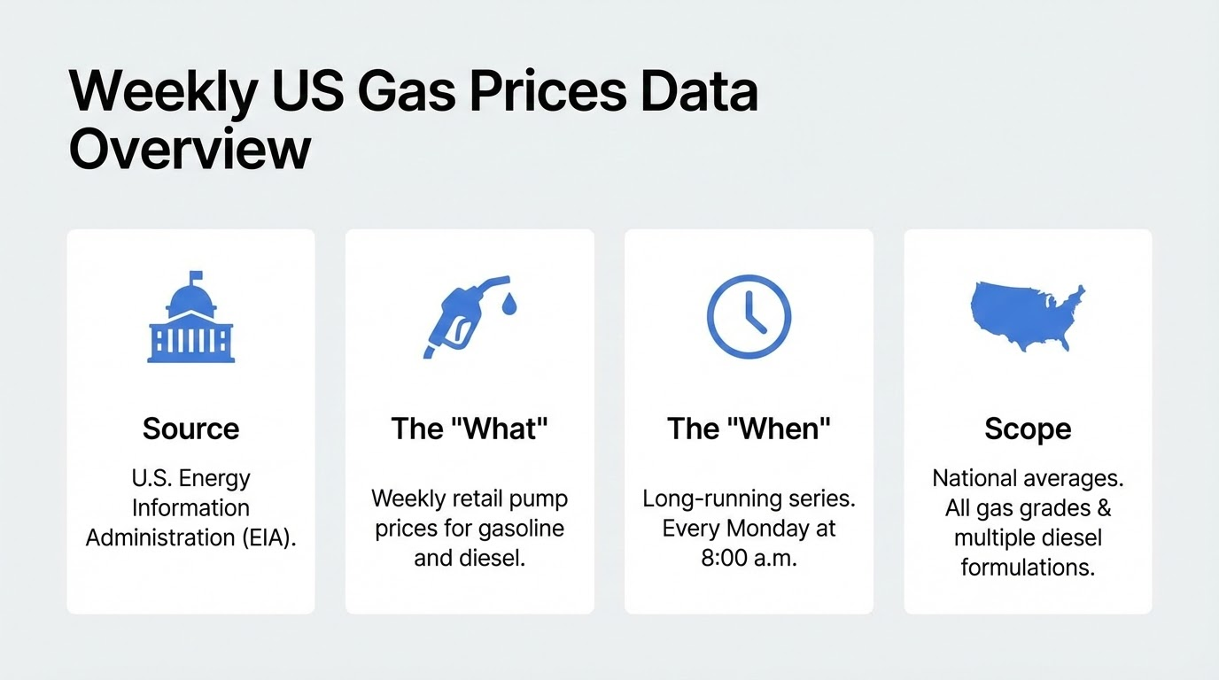

Slide 3
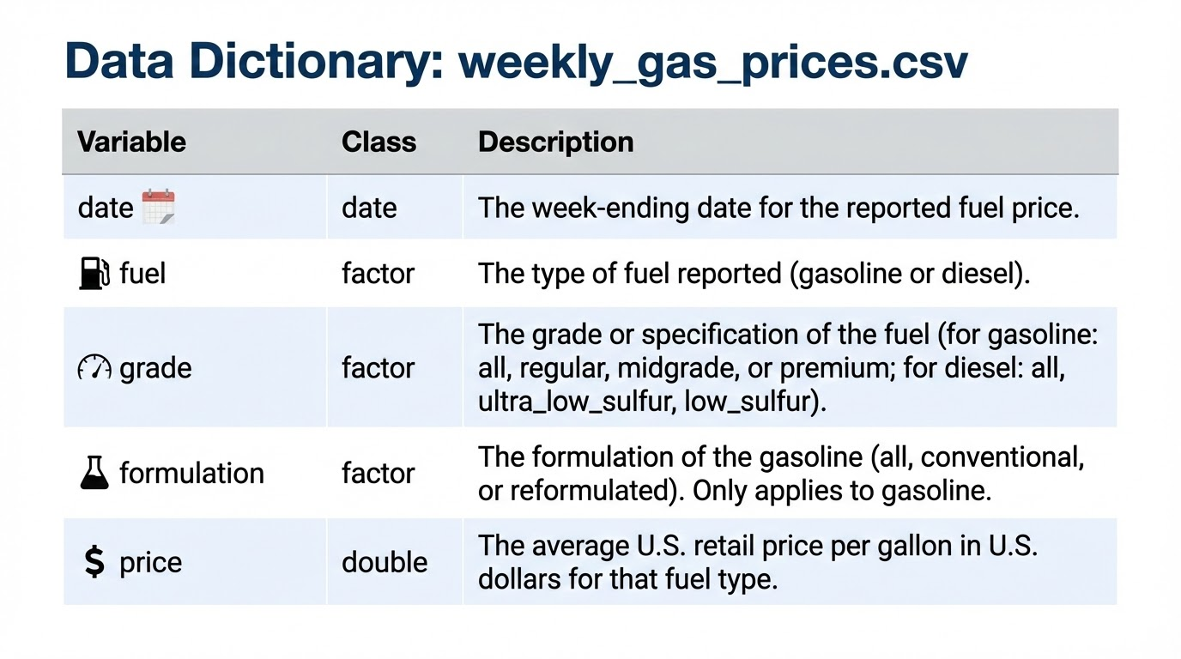

Slide 4
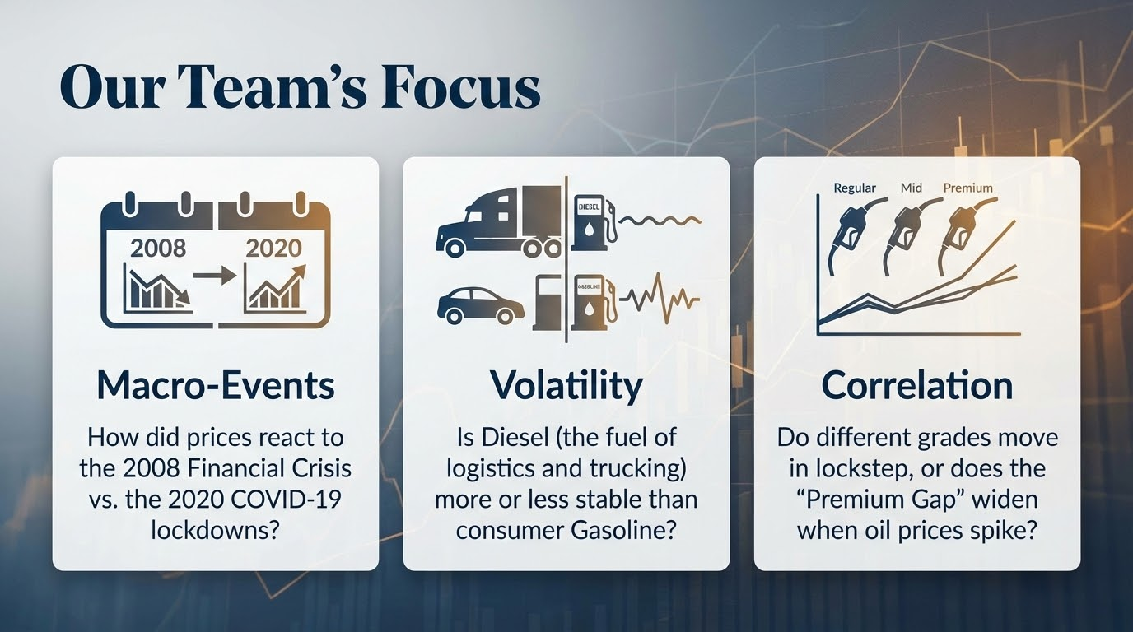

Slide 5
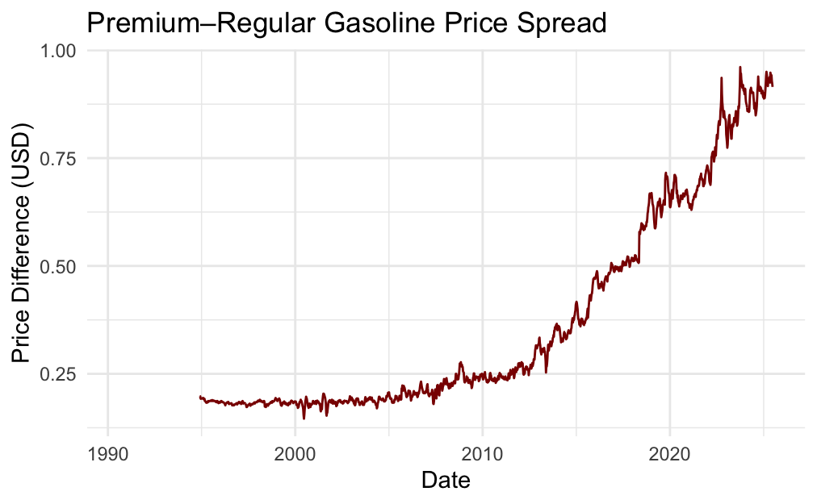
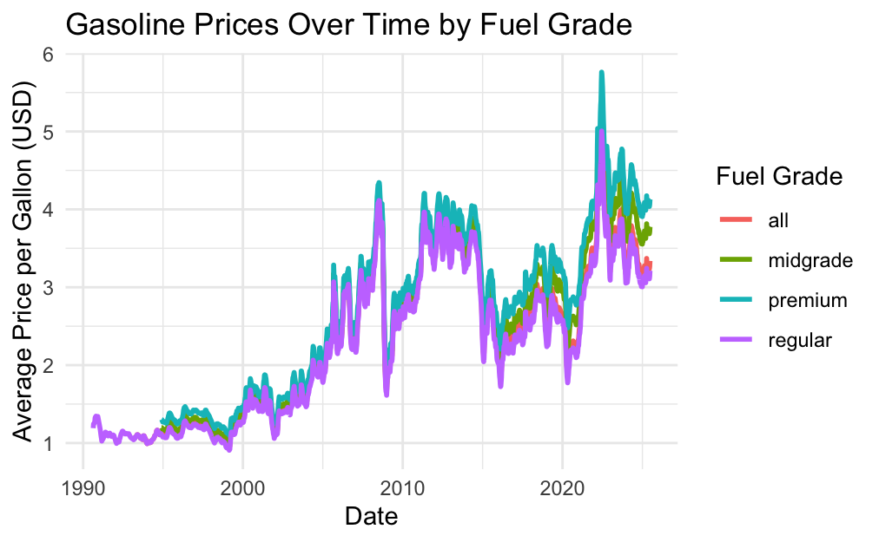
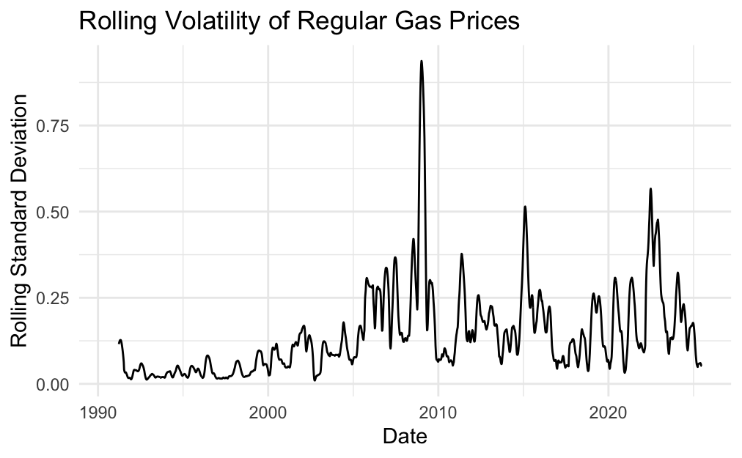
Mihir
Notes:
Graph 1:
Gas prices seem to fluctuate at the same rate and move very closely together
Shows that gasoline prices are influenced by the same market factors (crude oil for example), regardless of fuel grade
Also purchased at almost equal quantities (demand for each fuel grade is about the same)
You’ll notice a few major spikes in gas prices (just before 2010 and around 2021-2022)
Correlates to major economic events, specifically the Great Recession/COVID-19 pandemic
Gas prices were inflated around then

Slide 6
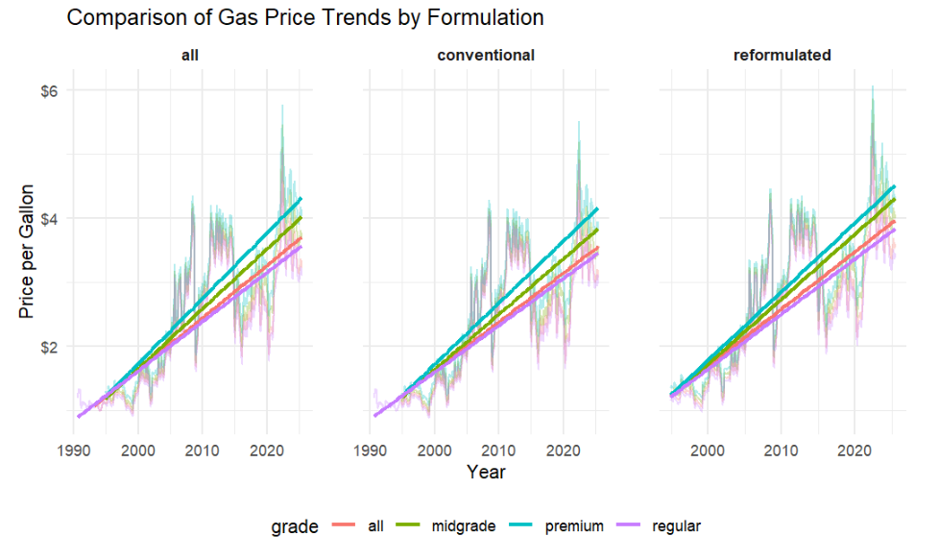
Teju
Notes:
Comparison of gas price trends based on formulation:
All types of formulation seems to have similar increasing trends over the years with peaks at 2008 and 2021, due to the market collapse and the pandemic
Its clear that regarding grade, premium is the most expensive followed by midgrade and regular, and that reformulated gas is more expensive than conventional gas

Slide 7
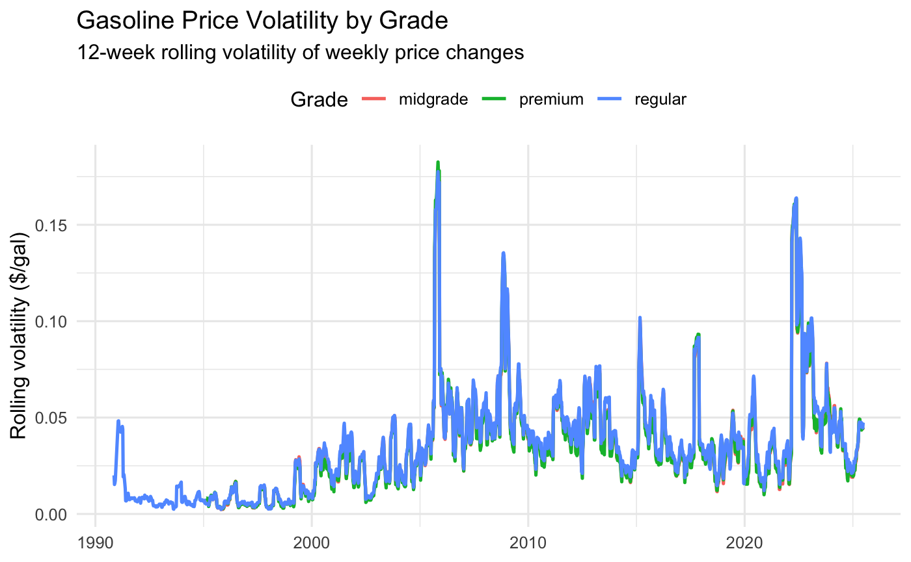
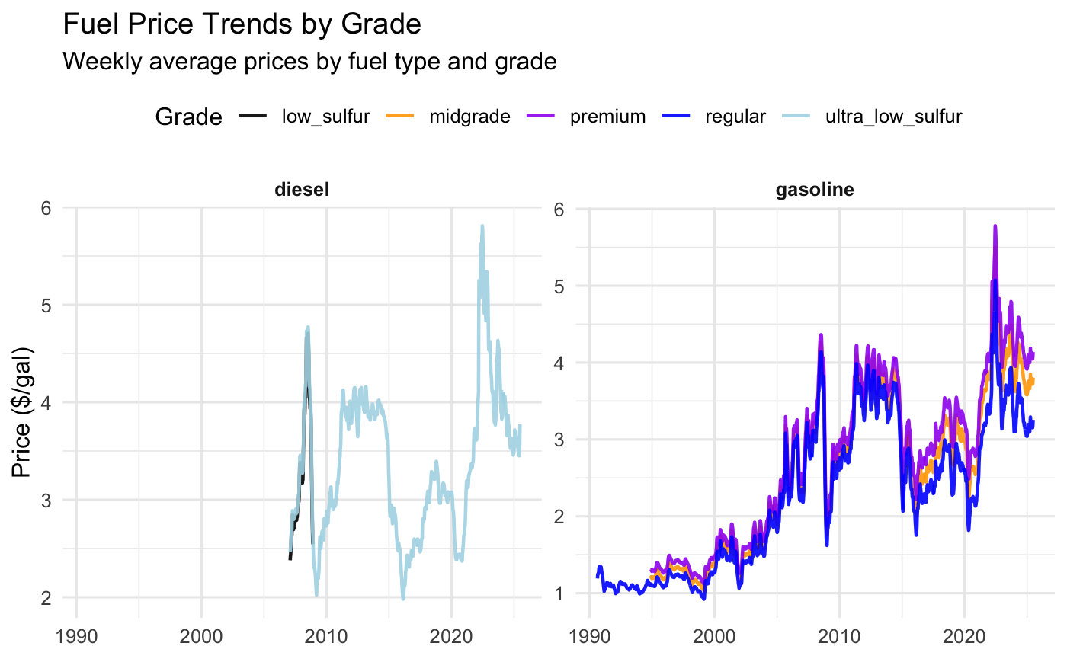
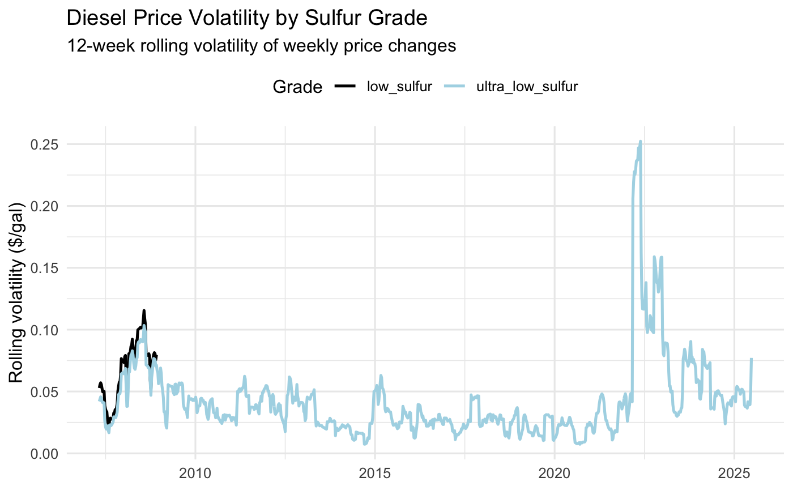
Daniel
Price volatility, how unstable fuel prices are over time
Each point summarizes fluctuation over past 3 months
Gasoline, several volatility spikes sharply around 2008 and again in the early 2020s
Diesel, generally shows lower and smoother volatility, especially during 2008
Diesel prices are more stable and inelastic, likely because diesel demand is tied to transportation and industrial use that can not easily adjust in short term

Slide 8
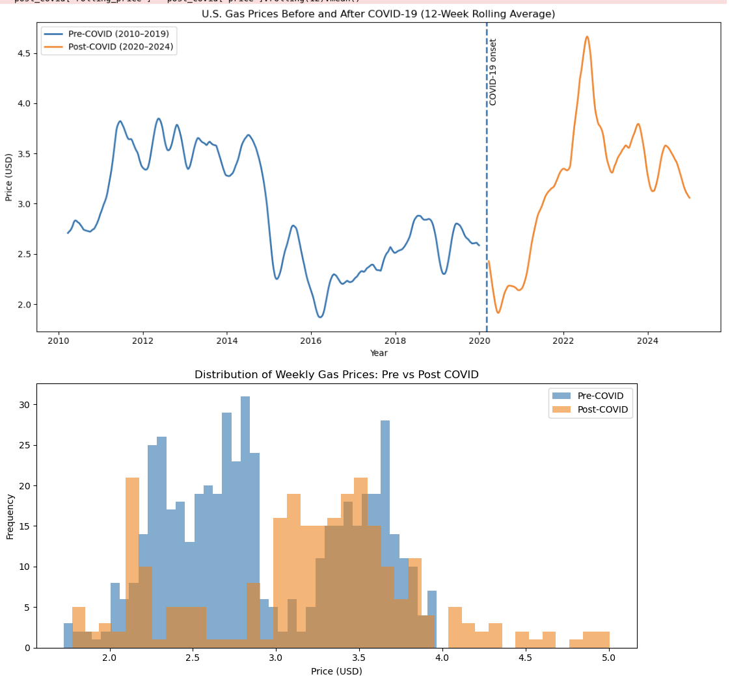
Muhammadali
Gas prices before and after Quarantine
Average price of gas from 2010 - 2025
Frequencies of gas prices before and after quarantine

Slide 9
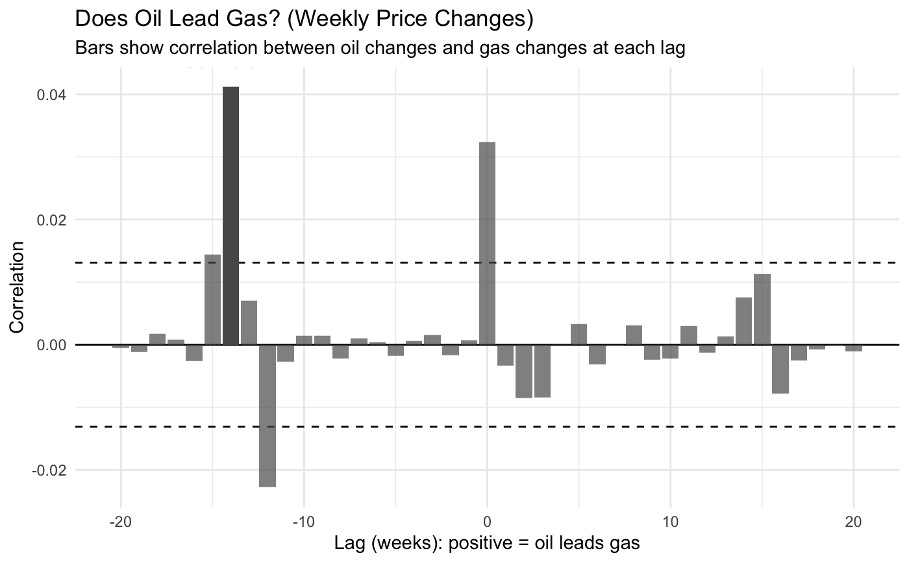
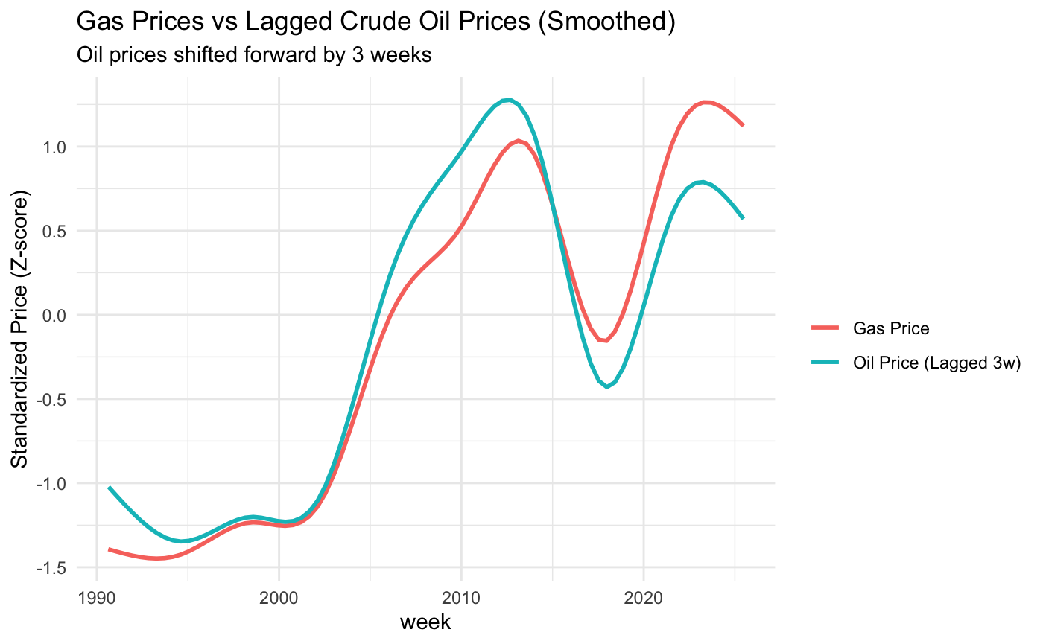
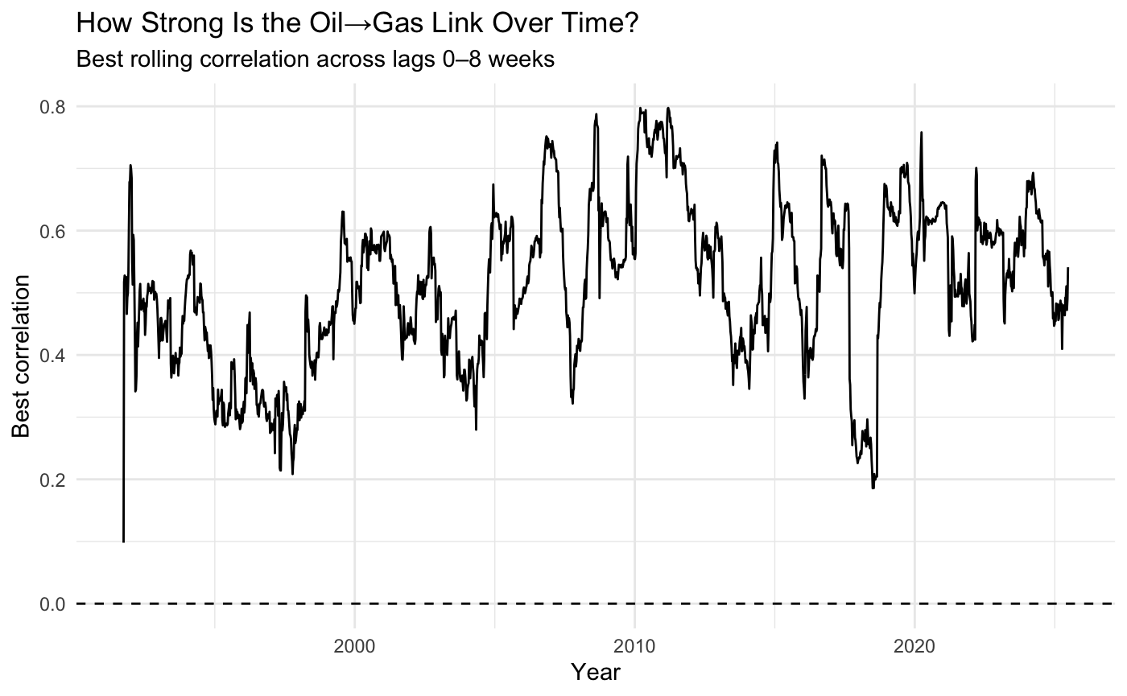
Pranav
Oil and gas prices move together in the long run, but week-to-week oil price changes do not consistently lead gas price changes at a specific lag.
When oil prices rise or fall for long periods, gas prices follow the same pattern, but with smoother and slightly delayed movements.

Slide 10
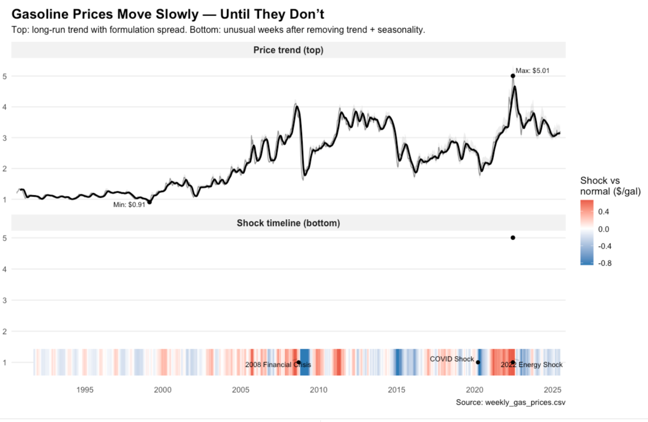
Kerry
Gas prices move slowly most of the time, but real pain comes from short shock periods.
2008 and 2022 stand out as unusually extreme weeks, not just high prices.
The market is a range, not a single price, spreads widen during instability.
Seasonality explains routine swings, but not major price spikes.
Notes:
The top panel shows the long-term price behavior. The shaded band represents the range of prices across different gasoline formulations each week. The thin line shows the typical weekly price, and the thicker line smooths that series to reveal the overall trend. This panel shows that prices generally move gradually over time, but the spread between formulations widens during periods of instability.
The bottom panel focuses on abnormal behavior. It removes the long-term trend and the usual seasonal pattern and highlights weeks when prices were unusually high or low compared to what is normally expected for that time of year. Red areas indicate unusually high prices, while blue areas indicate unusually low prices.
Together, the panels show that gasoline prices are driven by two forces: a slow, long-run trend and short, sharp shocks. Most of the dramatic price changes people remember come from these shock periods rather than from gradual price movements.

Slide 11
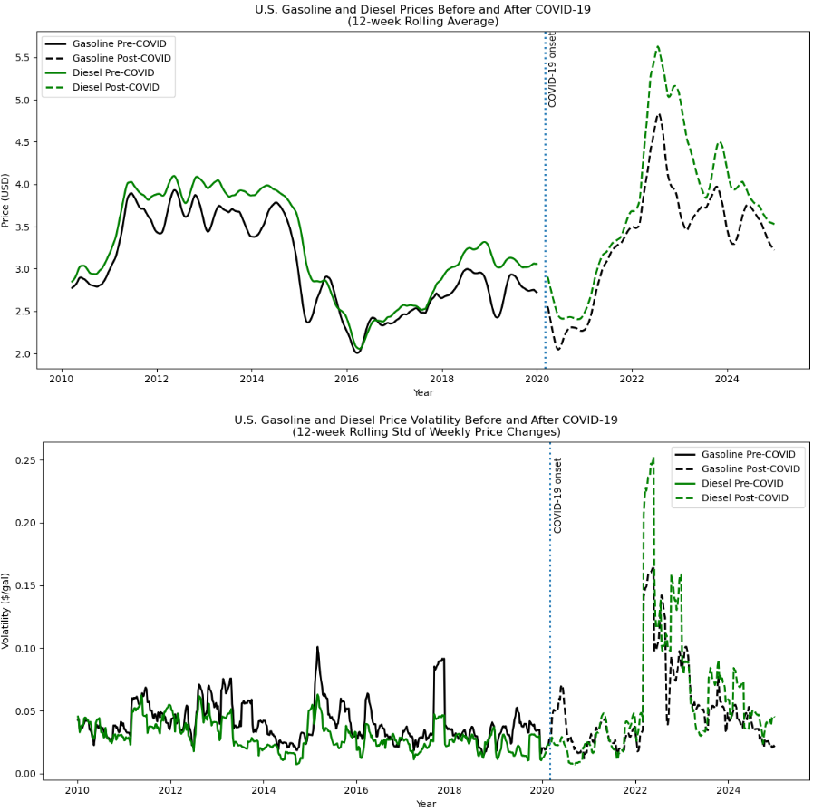
Killer Graph
To answer our initial question: Is diesel more volatile?
Historically, no.
But in a post-COVID world, the rules changed. We aren't just paying more; we are living in a much more unpredictable energy market.

